Slide 1
Brain Alarm
Product made by:
Al Fahim
Milton Moy

Slide 2
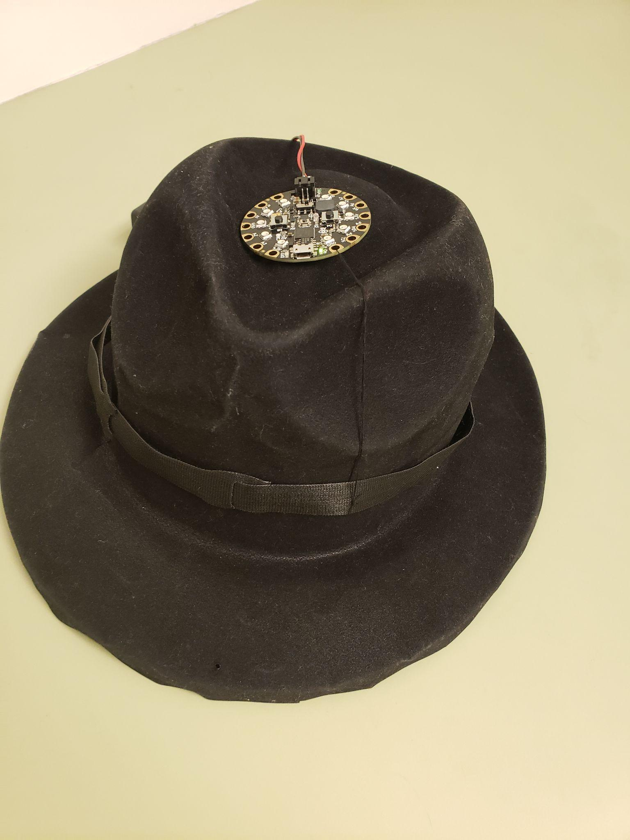
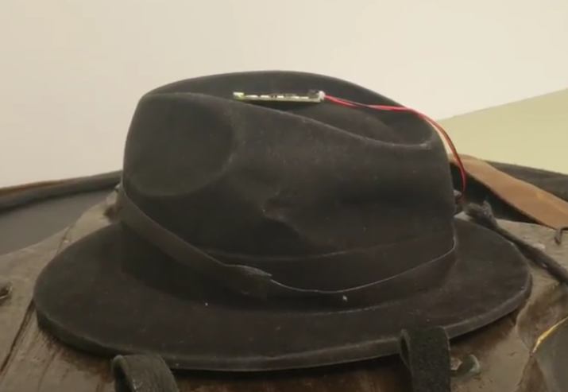

Slide 3
Background/ Overview
Keeps you awake
Puts you to sleep
Keeps you alert and focus on task
We wanted to make a product that will reduce fatigue accidents and keep you safe and focus. This item is best used for situations where you need to have your full attention on. This product best targets college students who gets exhausted from life and work.

Slide 4

Features Incorporated
If statements
While loops
Motion X & Y
Slide Switch
Right Button

Slide 5

Challenges and possible upgrades
Challenges :
Getting the while loop to work
Assigning variables frequency tones
Future upgrades:
More Customization (Example on the right)
Captive touch options
More sounds
Maybe more aesthetic appeal with pixel colors

